Slide 1

Javazone Workshop Storm Framework: Making sense of tweets
Jon Espen Ingvaldsen
Qadeer Ahmad

Slide 2



The Old Days

Slide 3

Apache Hadoop
Big Data software framework
Filesystem (HDFS)
MapReduce engine
Prominent users
Yahoo!
Facebook

Slide 4
Map / Reduce
How does it work???

Slide 5





INPUT
OUTPUT

Slide 6


Slide 7




MAP
REDUCE

Slide 8


Slide 9





Common Big Data Architectures
MapReduce job
?
?

Slide 11



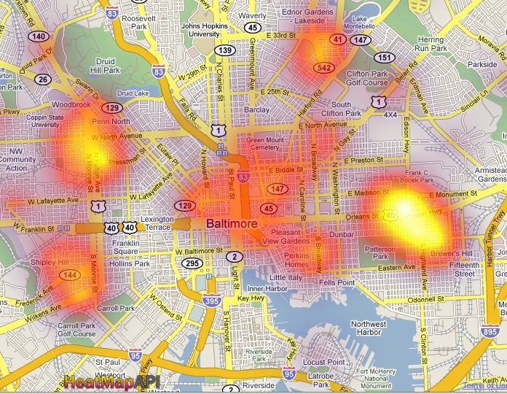
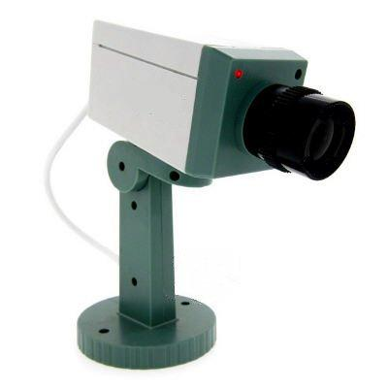

Slide 12
Storm – Continuous Monitoring
Storm topology
MapReduce job

Slide 13








Architecture
topology
bolt
spout

Slide 14
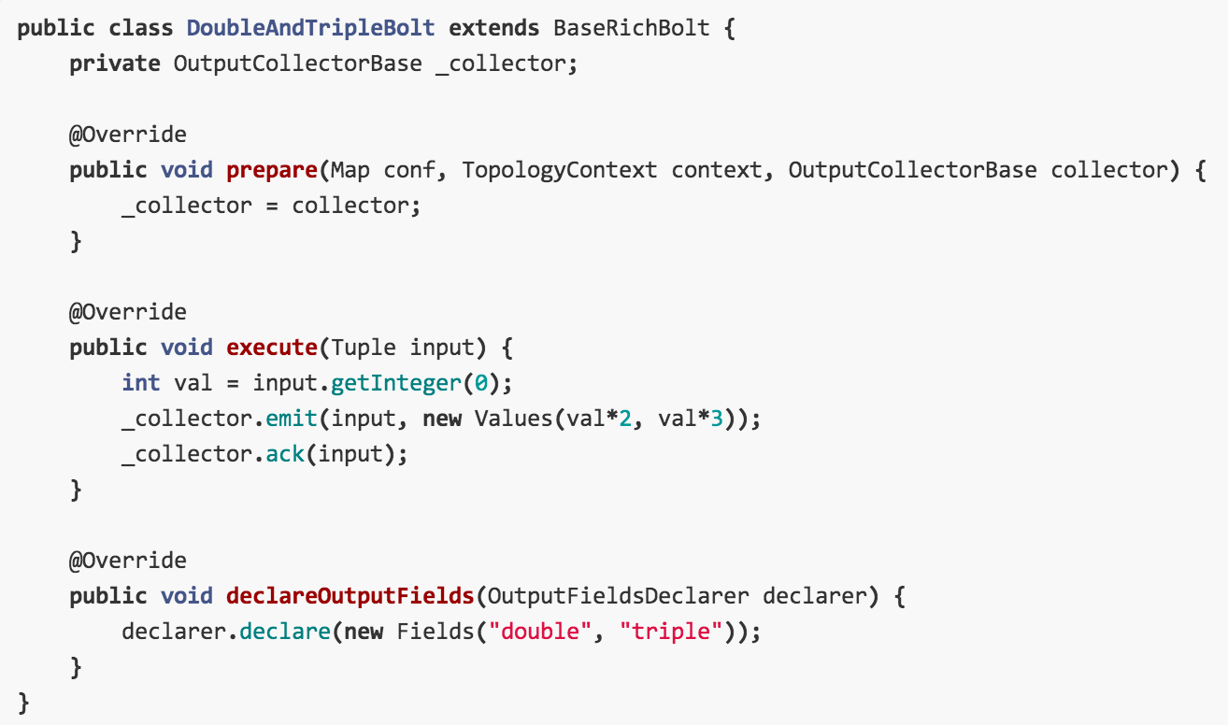
Example code

Slide 15
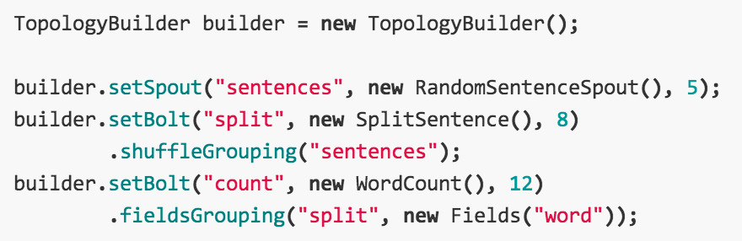
Example code

Slide 16

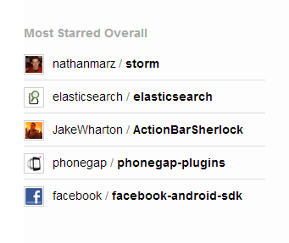
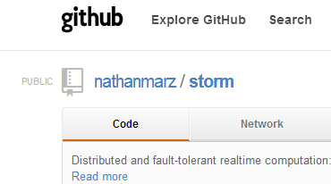
Aktivt miljø
storm-project.net

Slide 17


Sammendrag
Stormby Twitter
jon.espen.ingvaldsen@kantega.no
qadeer.ahmad@kantega.no

